Slide 1
Term Test 1 Review

Slide 2
Agenda
Python Identifiers
Built in data types: int, float, str, bool
Operators
Functions
File reading/writing
Control-flow statements
if/ elif / else statements
while statements

Slide 3
Python Identifiers
Which of the following is not a valid variable name in Python?
X2
man_of_war
_Beverly_Hills_90210
Medusa_
None of the above

Slide 4
Boolean Values
The variable dollars is assigned the value 8. Which expression produces the value True?
8 = dollars
dollars == 8
Dollars == 8
dollars != 8
8 >= dollars

Slide 5
Type Casting
What is the output of int(72.8)
‘72’
72
73
72.0

Slide 6
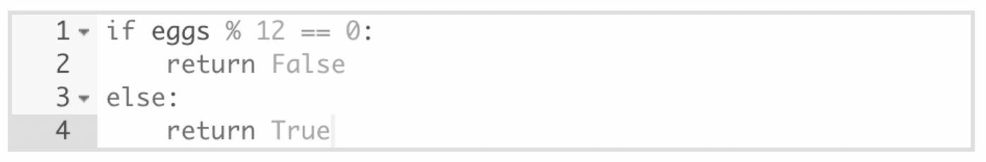
if-statements
Select statements equivalent to the statements above:
return eggs%12 == 0
return not eggs % 12 == 0
return not(eggs % 12 != 0)
return eggs % 12 != 0

Slide 7
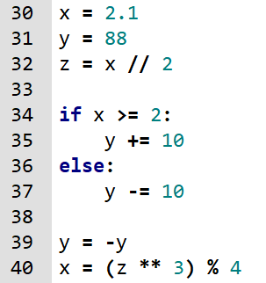
If-statements and variables
What are the values of the variables x, y, and z after line 40 this program?
1.0, 0, 1.05
1.0, -78, 1.0
1, -98, 1
1.0, -98, 1.0

Slide 8
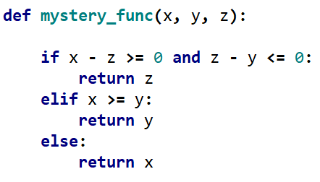
If-statements and functions
What line below is equivalent to mystery_func(x,y,z)? Bonus: Write an appropriate docstring for the function
min(x,y,z)
max(x,y,z)
min(x-z, z-y, 0)
min(x-z, z-y)

Slide 9
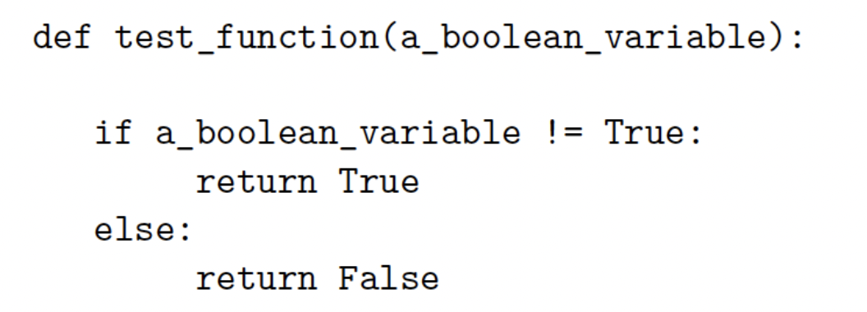
Functions and if-statements
Which of the following statements can replace the body of test_function and produce the same result?
return False
return a_boolean_variable
return True
return not a_boolean_variable
None of the above

Slide 10
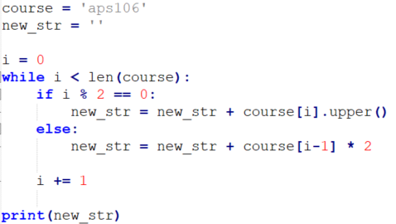
Strings and if-statements
What is printed when the code below is run?

Slide 11

Write the code: Inverse tanh
The inverse hyperbolic tangent function (tanh⁻¹(x)) can be estimated using the following series:
where -1.0 < x < 1.0 and N is the number of terms used in the approximation.
Part 1: Write a function that takes two parameters: x and N and computes and returns the approximation to the inverse hyperbolic tangent function. Do not use the math module.
Part 2: Write a program that prompts a user for values of x and N and then calls the function from part 1. If the user enters invalid values for x (>= 1 or <= -1) or N (non-positive integer), ask the user to enter the values again until they are valid. Finally, print the results.

Slide 12
Write the code: Operation create more data
Having learned that AI models are running out of data on the internet, you decide to record your conversations to produce more data to sell.
To create your prototype program that will automatically transcribe your conversations, you decide to start on the part of the code that will write your conversations to a file.
Task:
Write a program that repeatedly asks a user to enter some text input and then write the text to a file.
The program should end when the user enters “*DONE*”
The name of the file should be name_date_convo_log.txt where name and date are provided by the user at the beginning of the program
Example
Enter a name: Ben
Enter a date (YYYYMMDD): 20250213
Enter conversation text (or *DONE* to finish): Wow last week’s APS106 lab was so fun
Enter conversation text (or *DONE* to finish): Yeah! I always do the APS106 labs before my other assignments
Enter conversation text (or *DONE* to finish): *DONE*
File Ben_20250213_convo_log.txt contents
Wow last week’s APS106 lab was so fun
Yeah! I always do the APS106 labs before my other assignments

